Slide 1

New rail usage figures come out - what do you do?

Slide 2

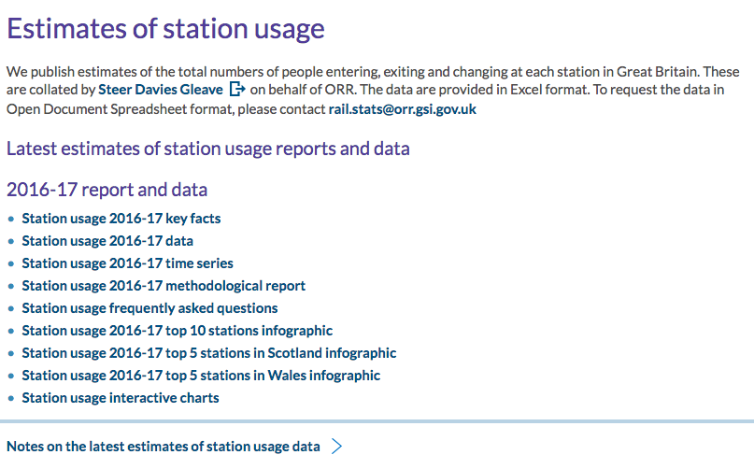
http://orr.gov.uk/statistics/published-stats/station-usage-estimates

Slide 3
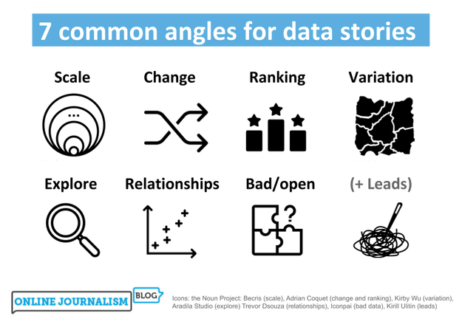
https://onlinejournalismblog.com/2020/08/11/here-are-the-7-types-of-stories-most-often-found-in-data/

Slide 4
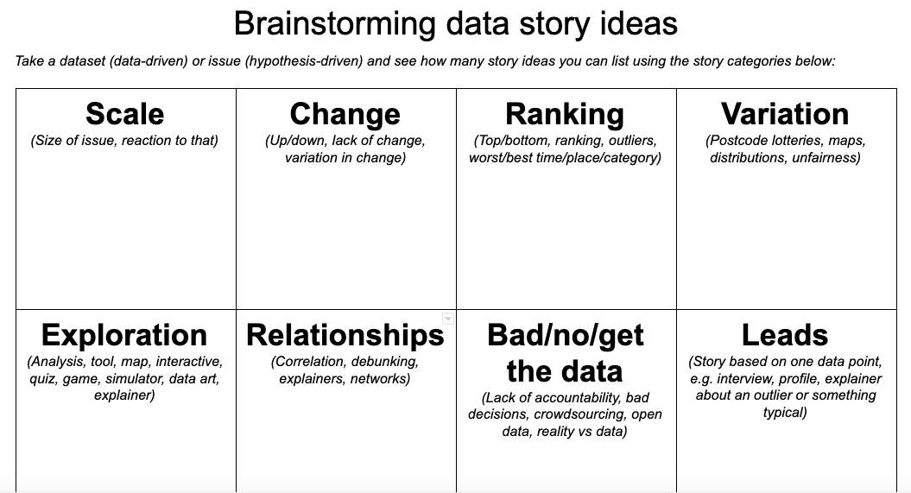
https://docs.google.com/document/d/1QSX7IN2oOzGFsrwF-mL_04F5ANyvkHWixfrOZPa7xsg/edit?usp=sharing

Slide 5
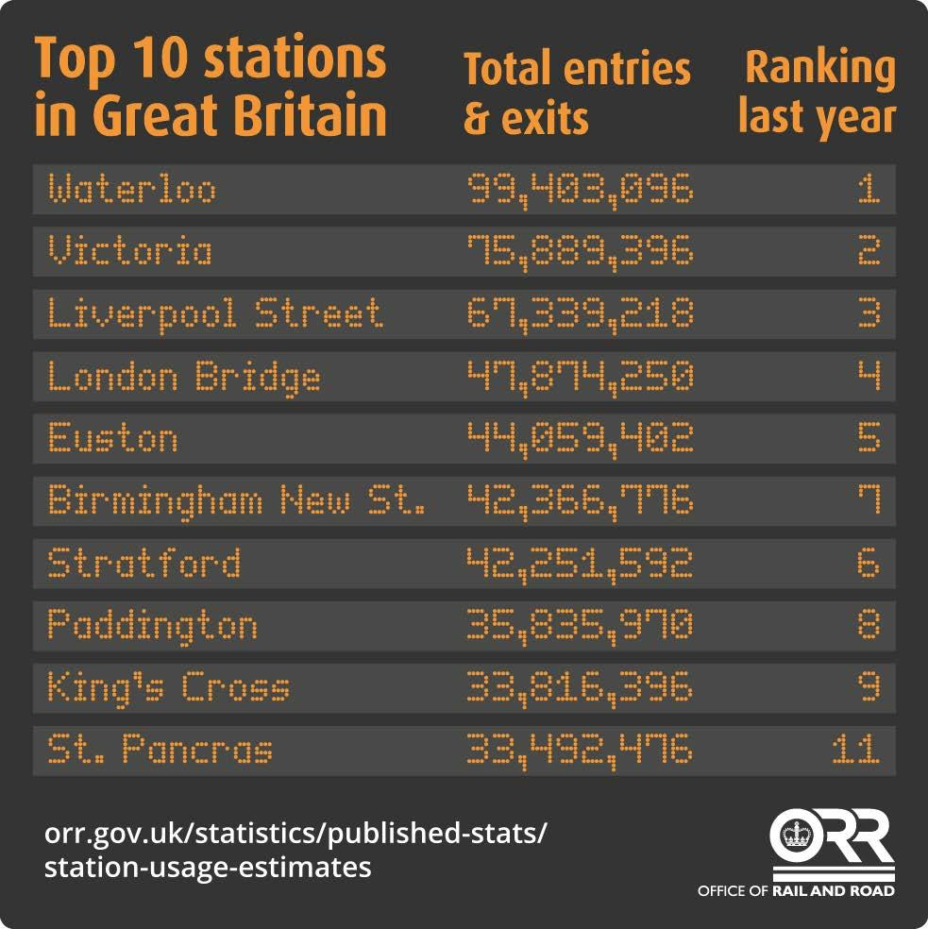
http://orr.gov.uk/statistics/published-stats/station-usage-estimates

Slide 6
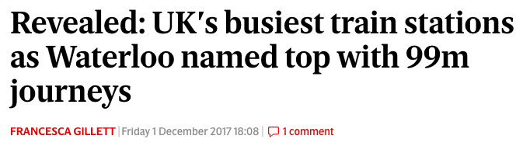
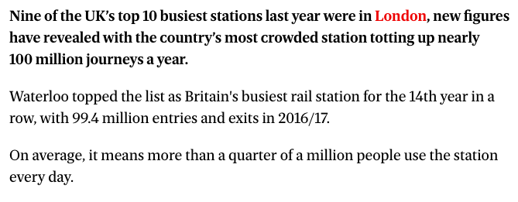
Headline verbs: ‘revealed’, ‘named’. Keywords.
“New figures” - not bogged down with source detail
Consider audience: London is the focus
No quotes. Who could they have interviewed?
Evening Standard;

Slide 7
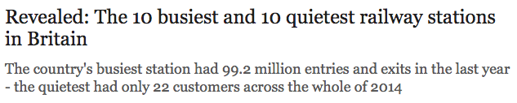
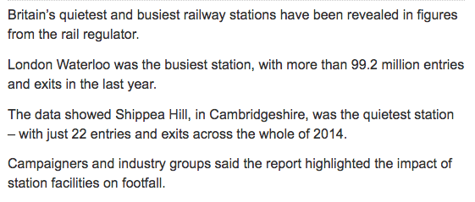
Style: sub-heading before intro
“Figures from the rail regulator” - no need to name yet
Moves into reaction by par 4
Secondary quote: “Told the BBC”
Telegraph

Slide 8
Inverted pyramid
1. New fact, according to new data/research/report
2. Context/more details: who/what; following X or leading up to Y
3. Quote of reaction - or further details. OR if NIB: skip to end
4. More context/background/reaction - alternate
End: A quote, or what happens next

Slide 9
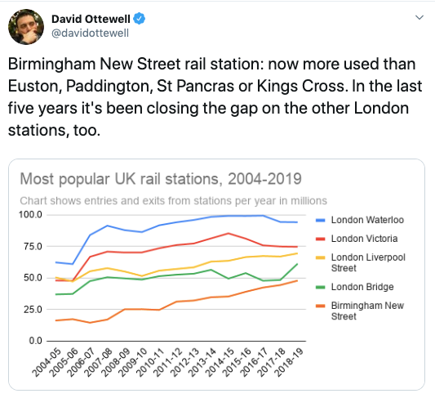
https://twitter.com/davidottewell/status/1217046338111787012

Slide 10
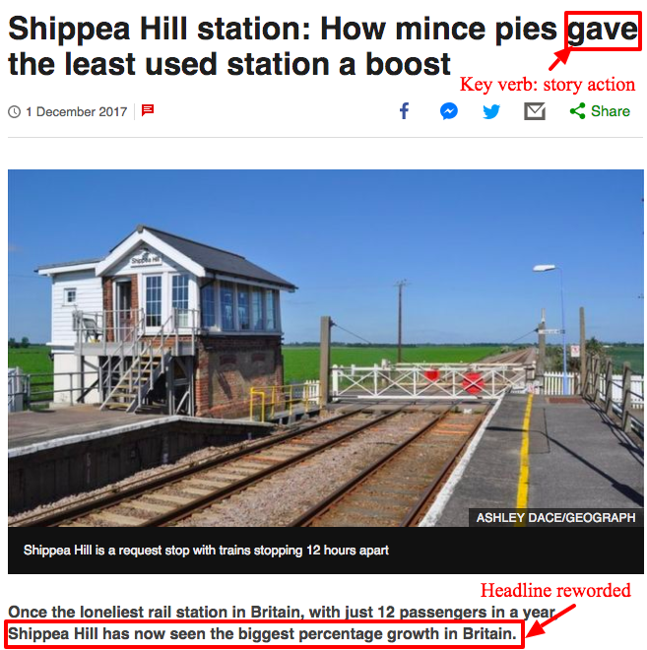
https://www.bbc.co.uk/news/uk-england-42196835
https://github.com/BBC-Data-Unit/least-used-station

Slide 11
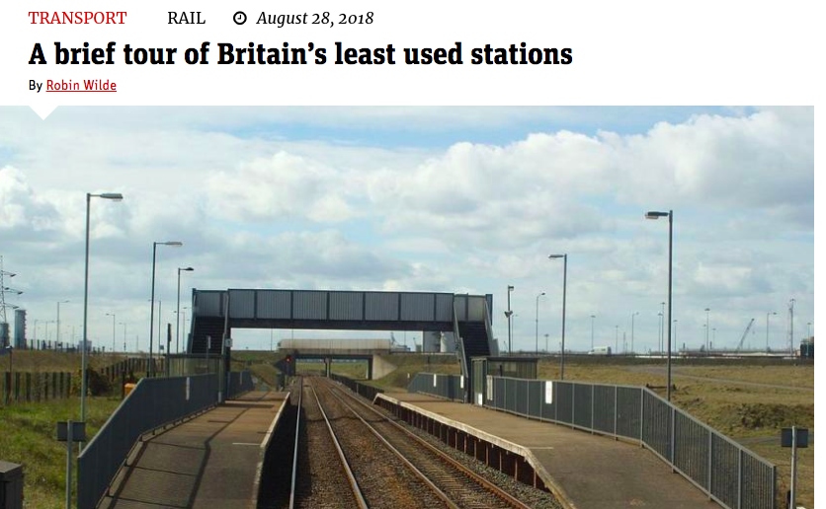
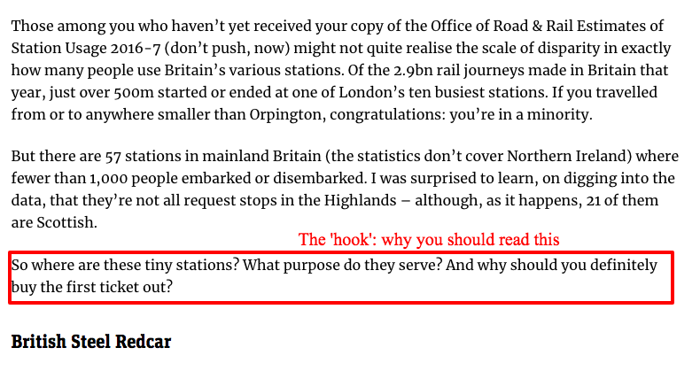
https://www.citymetric.com/transport/brief-tour-britain-s-least-used-stations-teesside-4156

Slide 12
Gender pay gap figures: a case study

Slide 13
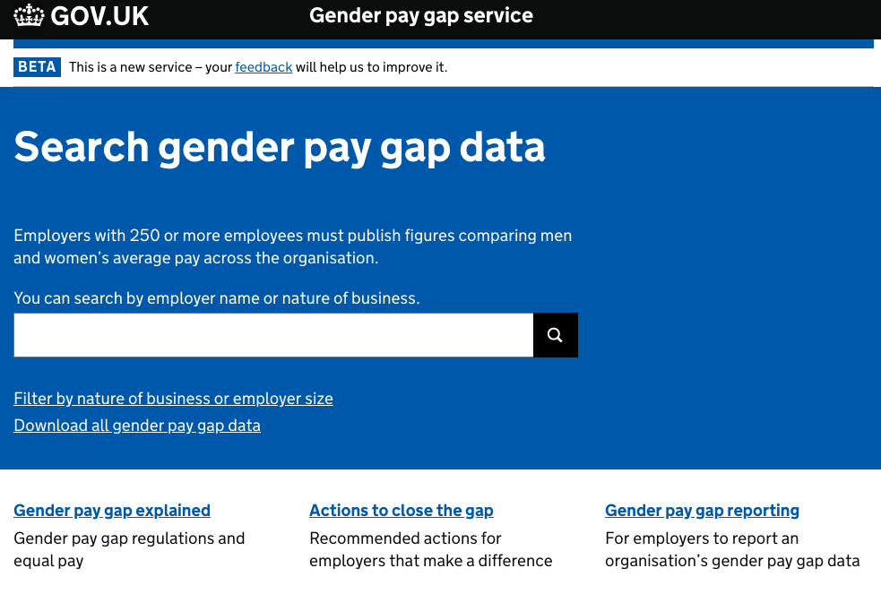
https://gender-pay-gap.service.gov.uk/

Slide 14
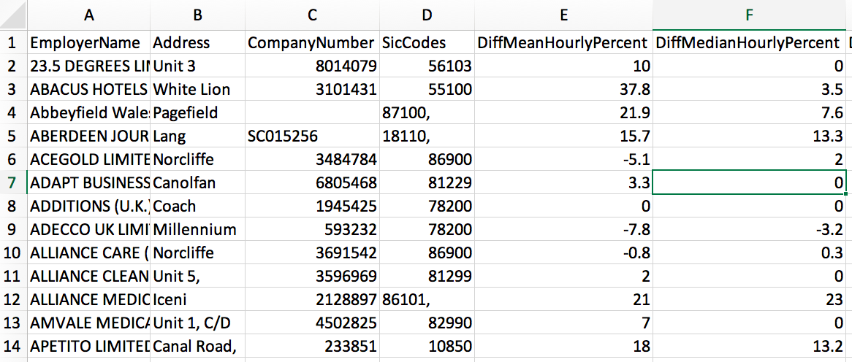
https://gender-pay-gap.service.gov.uk/

Slide 15
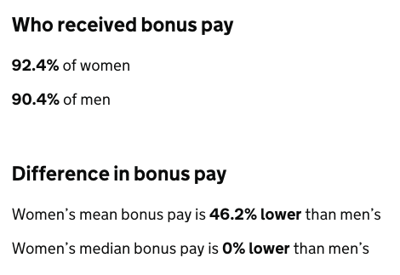
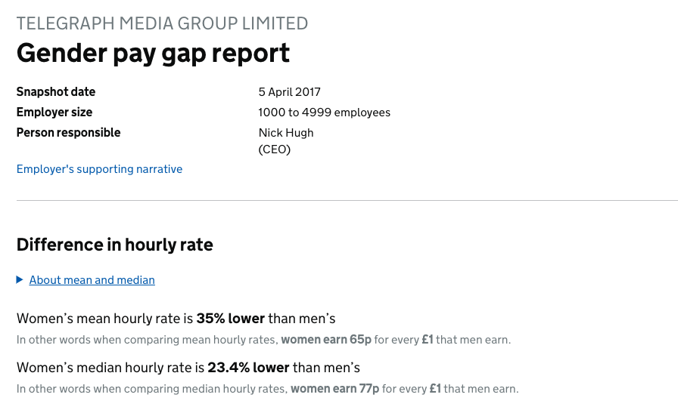
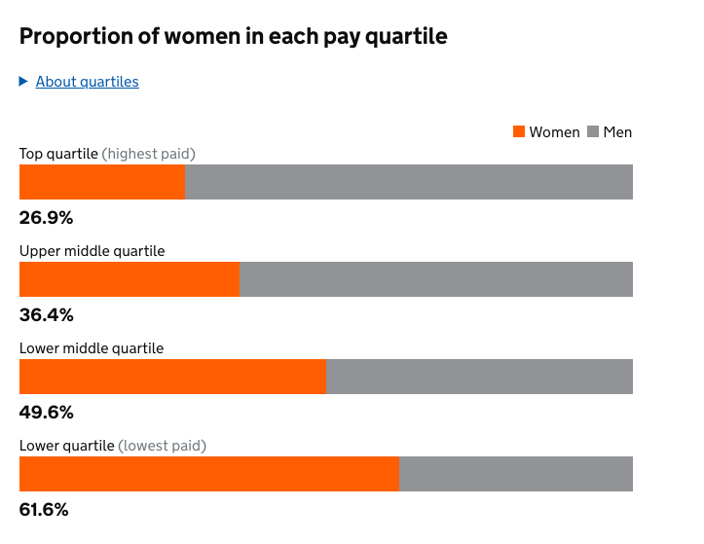
https://gender-pay-gap.service.gov.uk/viewing/employer-%2cd-EQDgBs_aYzIwbTF3O-UA!!/report-2017

Slide 16
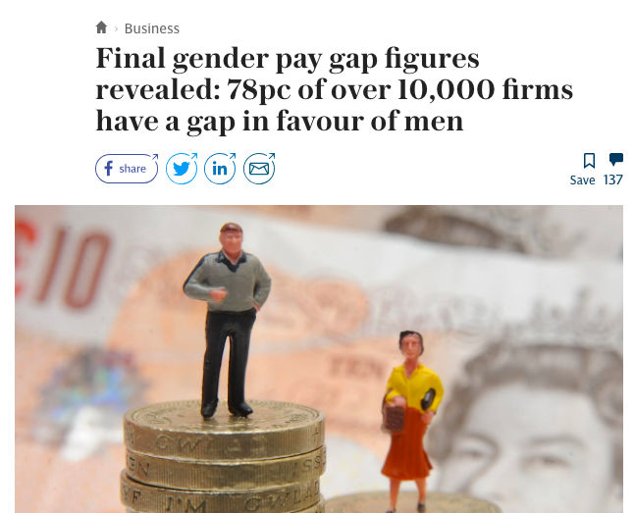
https://pinboard.in/u:paulbradshaw/t:gender+dj+pay
https://www.telegraph.co.uk/gender-pay-gap/ https://www.theguardian.com/world/gender-pay-gap

Slide 17
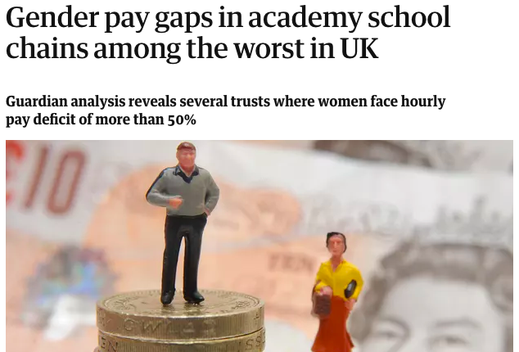
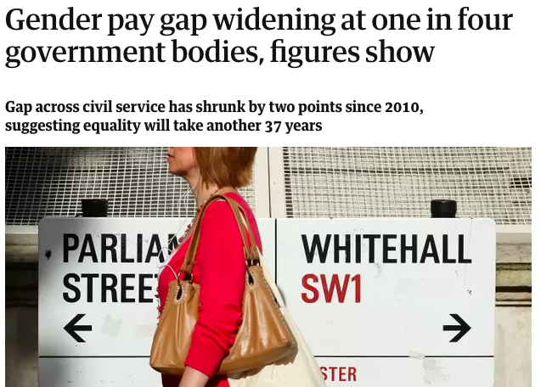
https://www.theguardian.com/politics/2017/aug/10/gender-pay-gap-widening-at-one-in-four-government-bodies-figures-show
https://www.theguardian.com/news/2018/mar/25/gender-pay-gaps-in-academy-school-chains-among-the-worst-in-uk

Slide 18
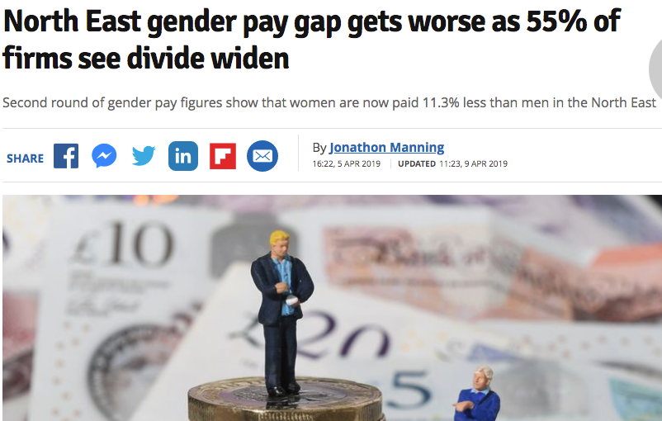
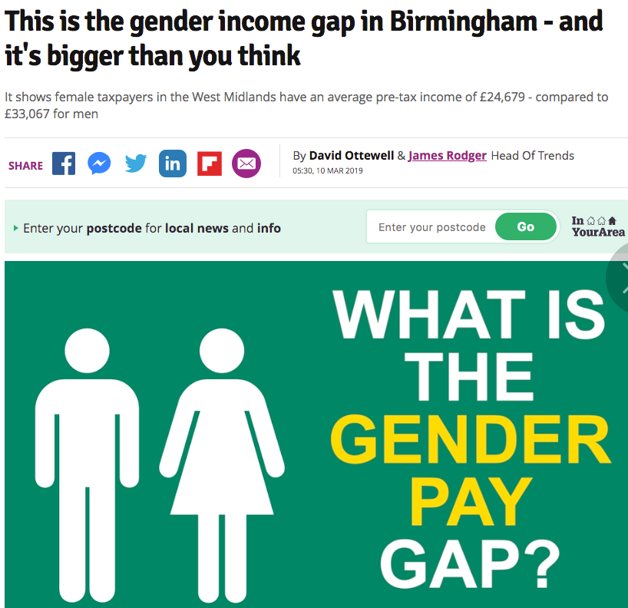
https://www.birminghammail.co.uk/news/midlands-news/gender-income-gap-birmingham-its-15940113
https://www.chroniclelive.co.uk/business/business-news/north-east-gender-pay-gap-16085565

Slide 19
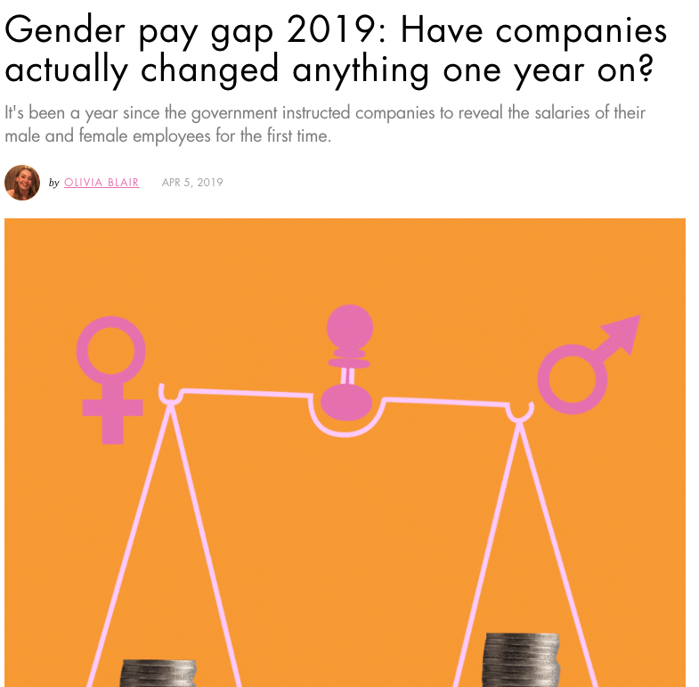
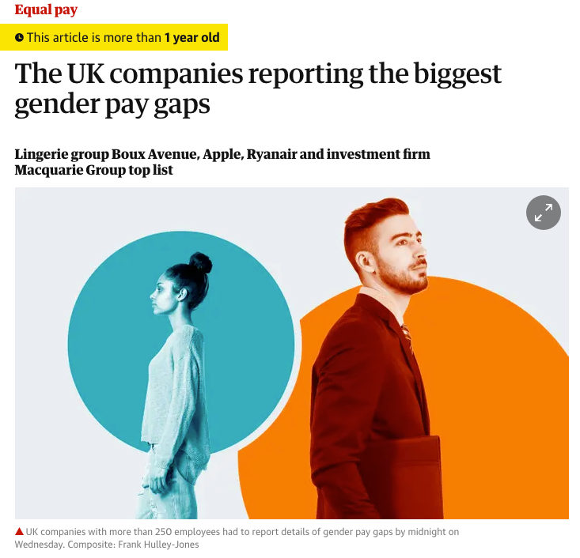
https://www.cosmopolitan.com/uk/reports/a27042068/gender-pay-gap-2019-best-worst-companies/
https://www.theguardian.com/society/2018/apr/05/the-uk-companies-reporting-the-biggest-gender-pay-gaps

Slide 20
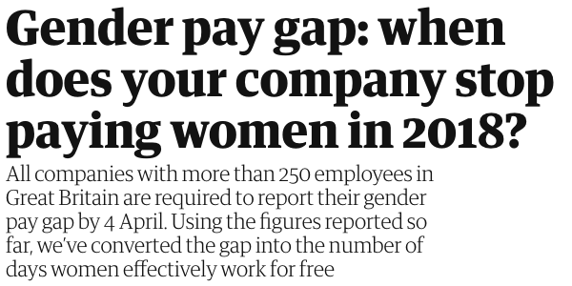
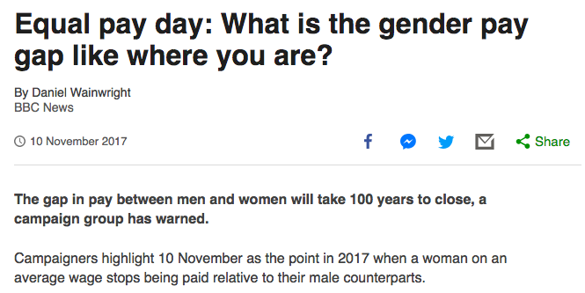
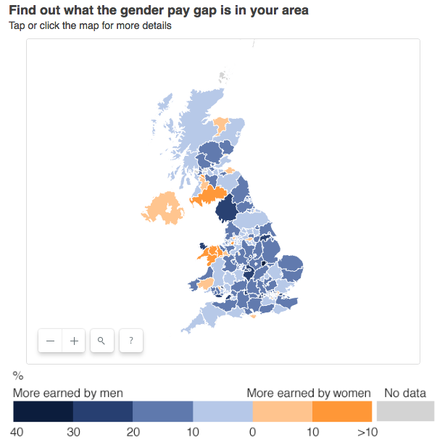
https://www.bbc.co.uk/news/uk-england-41805053
https://www.theguardian.com/news/ng-interactive/2018/apr/04/gender-pay-gap-when-does-your-company-stop-paying-women-in-2018

Slide 21
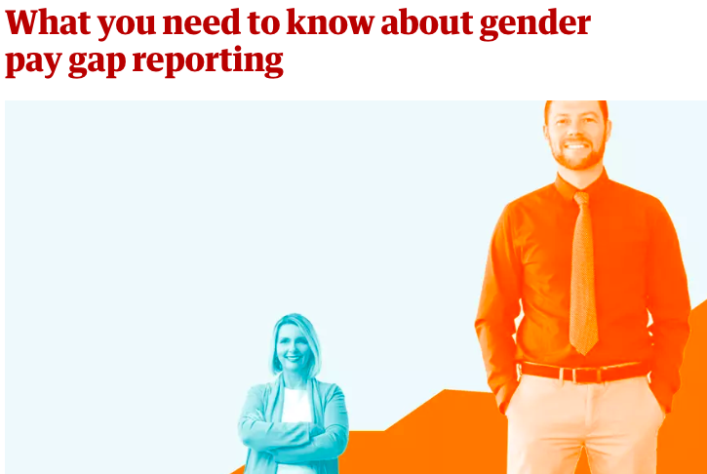
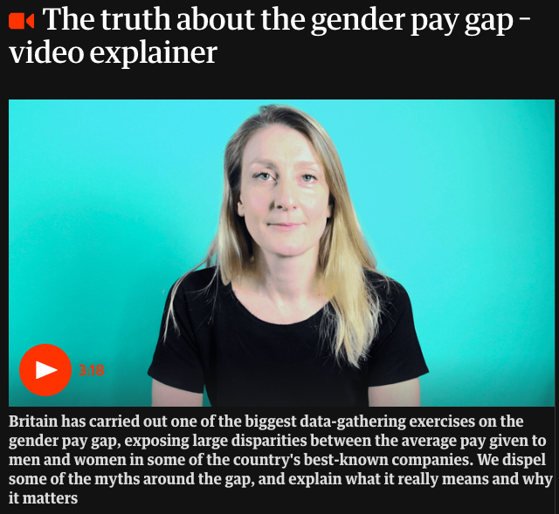
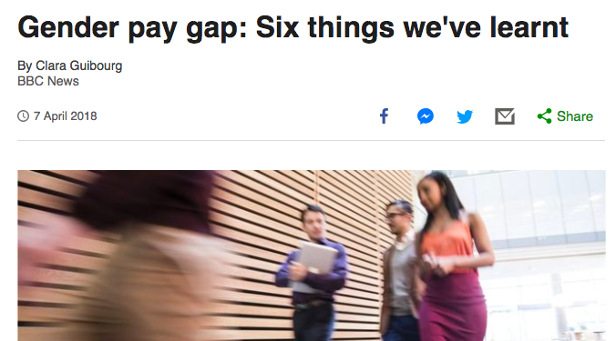
https://www.theguardian.com/news/2018/feb/28/what-you-need-to-know-about-gender-pay-gap-reporting
https://www.theguardian.com/news/video/2018/apr/06/the-truth-about-gender-pay-gap-video-explainer
https://www.bbc.co.uk/news/business-43668187

Slide 22
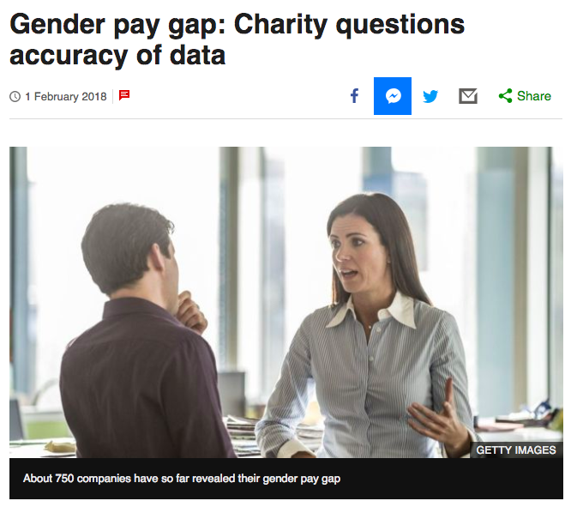
https://www.bbc.co.uk/news/uk-england-42611365
https://github.com/BBC-Data-Unit/gender-pay-gap

Slide 23
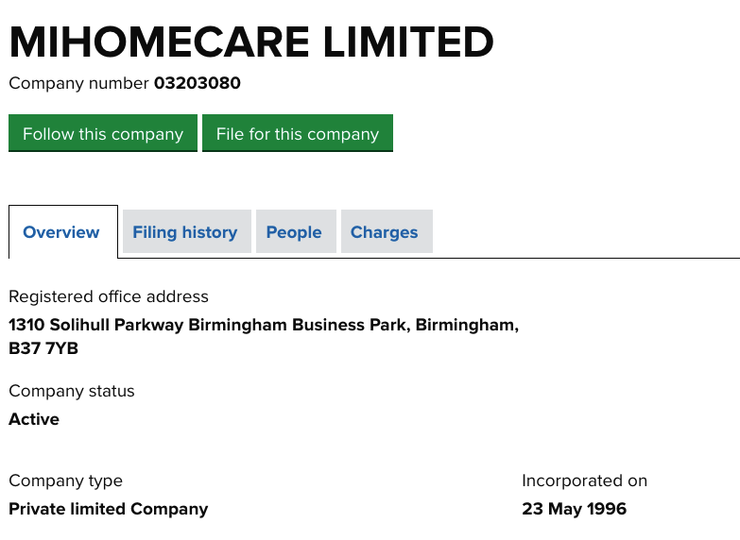
This one’s for free: in Birmingham this company has a 99% mean average pay gap in favour of women, but the median pay gap favours men. Why might that be? How might the company accounts give you more clues - and a possible story lead?

